Slide 1
CHM 5710
Chemical Structure and Bonding
Inorganic and Materials Chemistry
Part 2: Chemical Applications of Group Theory
MWF 11:15 – 12:05 am
Ken Hanson
Office Hours: MWF 1:00-2:00
Office: CSL 5006

Slide 2
Syllabus Day!

Slide 3
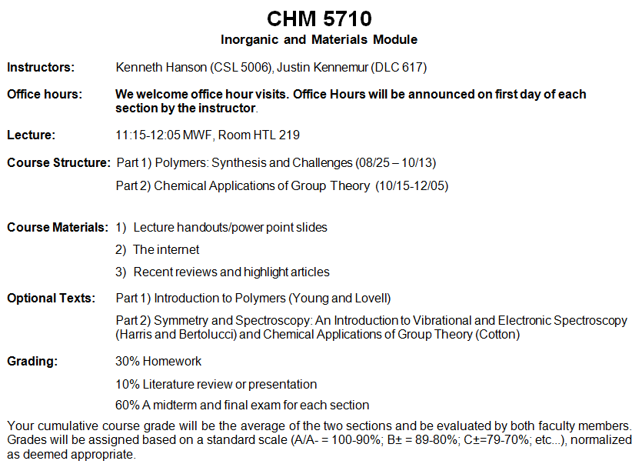

Slide 4

Inorganic Chemistry
What are the fundamental concepts in inorganic chemistry?

Slide 5

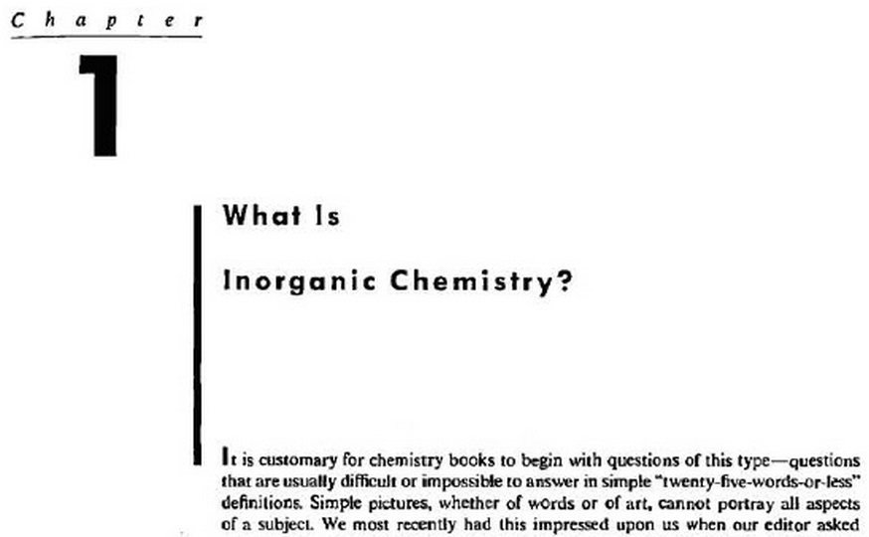
Inorganic Chemistry
Huheey, Keiter and Keiter Inorganic Chemistry, 4th ed.

Slide 6
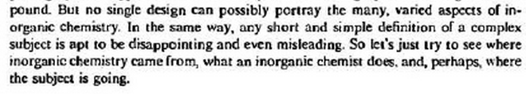
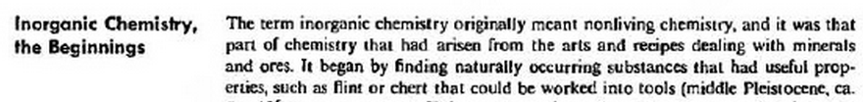


Inorganic Chemistry
Huheey, Keiter and Keiter Inorganic Chemistry, 4th ed.
Inorganic Chemistry (1st Edition)
“any phase of chemistry of interest to an inorganic chemist.”
-James E. Huheey

Slide 7


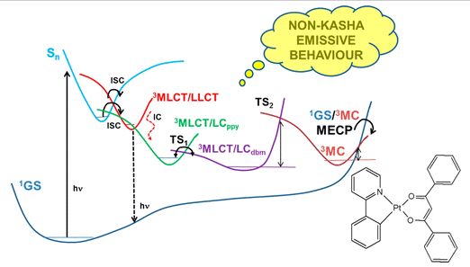
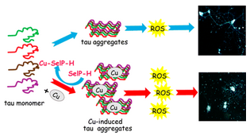
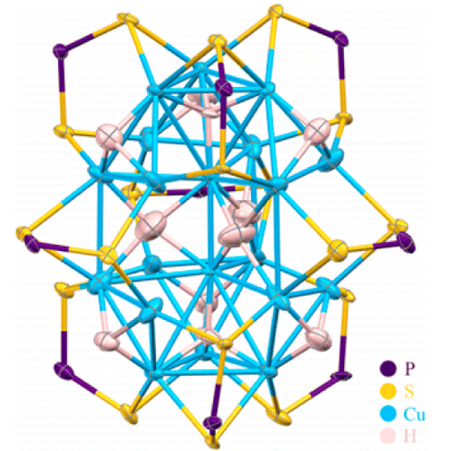
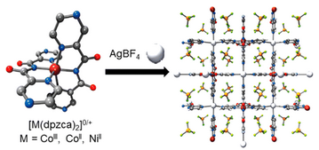

Slide 8
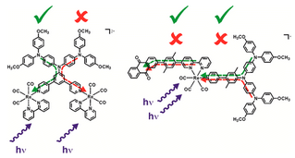
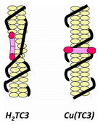
coordination chemistry
metals
metal oxides
metalloenzymes
bioinorganic
sol-gel
nanoparticles
metal-organic frameworks
metal ion sensing
quantum dots
semiconductors
ceramics
conductive polymers
nanotubes
graphene
“any phase of chemistry of interest to an inorganic chemist.”
-James E. Huheey

Slide 9
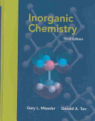
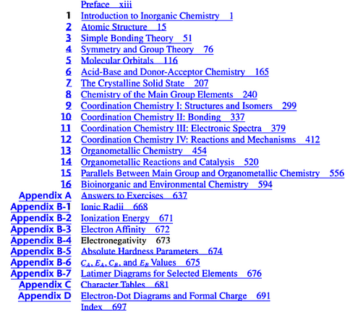
Inorganic Chemistry
Miessler and Tarr, Inorganic Chemistry

Slide 10
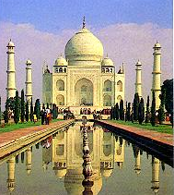
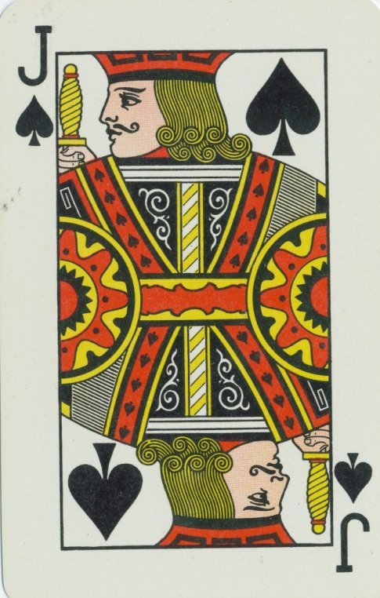
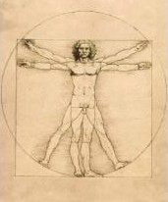
Group Theory
Group theory (chemistry)- The mathematical application of symmetry to an object to obtain knowledge of its physical properties.

Slide 11
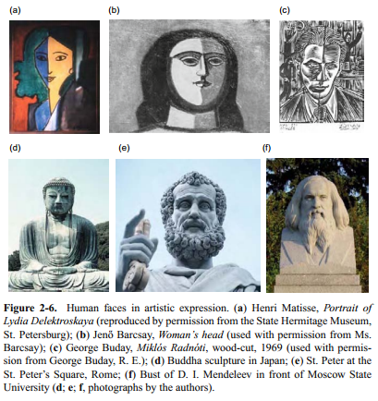
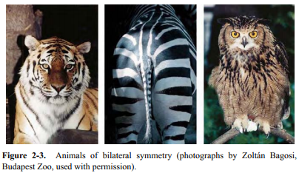
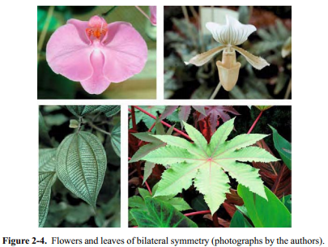
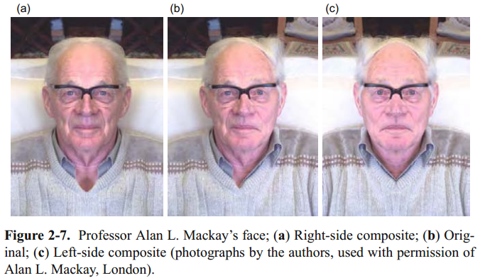
Symmetry Cliché
Symmetry Through the Eyes of a Chemist

Slide 12
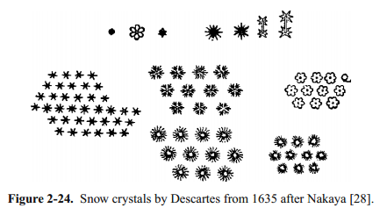
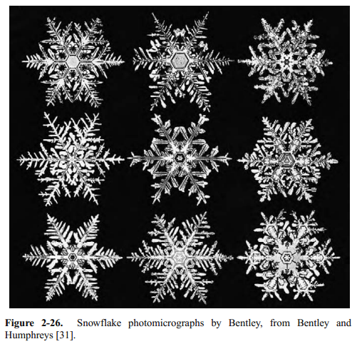
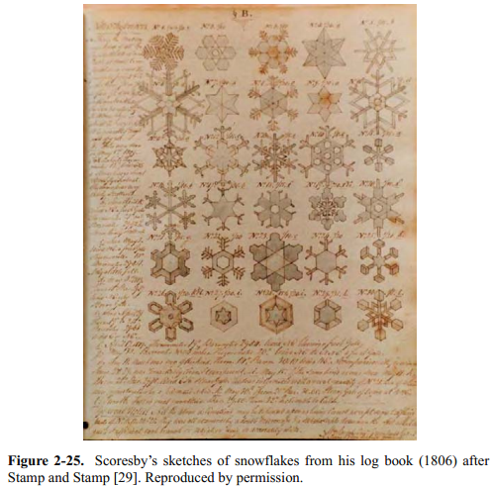
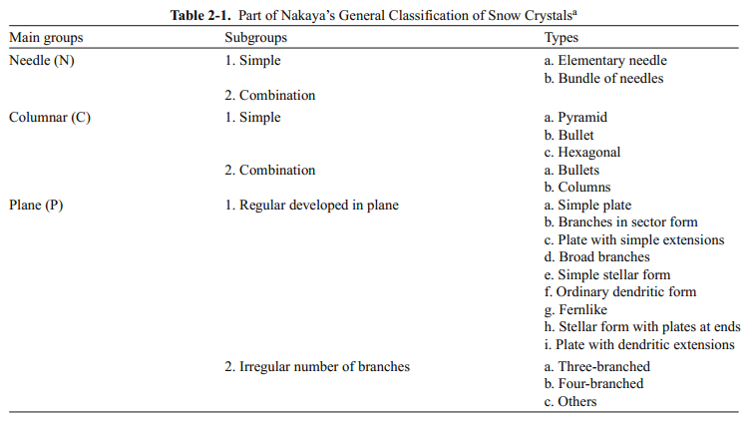
Symmetry Cliché
Symmetry Through the Eyes of a Chemist

Slide 13
Applications of Symmetry
Symmetry (group theory) in cryptography
Symmetry breaking of strong and weak forces in the early universe
Symmetry (group theory) was used to predicted the existence of many elementary particles before they were found experimentally
Modern particle physics would not exist without group theory
X-ray crystallography
Spectroscopy
Quasicrystals-Periodic structure that lacks translational symmetry, has only local symmetry. (2011 Nobel Prize in chemistry, Dan Shechtman)

Slide 14
Group Theory
Group theory (chemistry)- The mathematical application of symmetry to an object to obtain knowledge of its physical properties.
Who has heard of group theory?
Who has had Inorganic Chemistry?
Who has covered group theory in Inorganic Chemistry?

Slide 15
What could be covered?
Definitions and Theorems of Group Theory
Symmetry Elements/Operations
Symmetry Classifications
Dipoles
Optical Isomers
Representations of Groups
Irreducible Representations
Molecular Orbital Theory
Symmetry-Adapted Linear Combinations
Projection Operators
Polarizations
Orbital Diagrams
Term Symbols
Expansion coefficients
Crystal Field Theory
Ligand Field Theory
VSEPR
Selection Rules
Vibrational Modes
Infrared Spectroscopy
Raman Spectroscopy
Electronic Spectroscopy
Fluorescence
Phosphorescene
X-ray Crystallography
Space Groups
Lattice Symmetry
3-D Space Groups
etc…

Slide 16
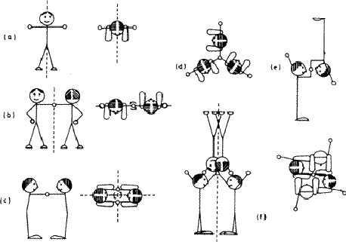
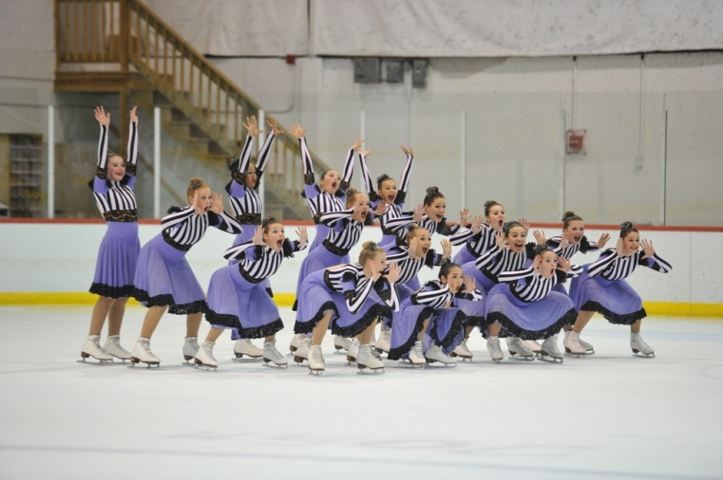
What will be covered?
Intro to Symmetry Elements and Operations
Point Groups Types/Assignments
Dipole Moments and Chirality
Rules that Govern Symmetry
Character Tables
Using Character Tables
Orbital Diagrams
Electronic Spectroscopy
Vibrational Spectroscopy
-Infrared
-Raman
Crystallography (maybe)

Slide 17
Course Goals
Turn you all into group theorists?
Overview of group theory (in chemistry)
Learn about the tools that are available
Learn some of the language
To appreciate the foundations of current knowledge/technology
Fill your toolbox
How we teach chemistry
Reality
Analytical
Physical
Organic
Analytical
Physical
Organic
Inorganic
Biochem
Inorganic
Biochem
Your answer is here
You are here

Slide 18
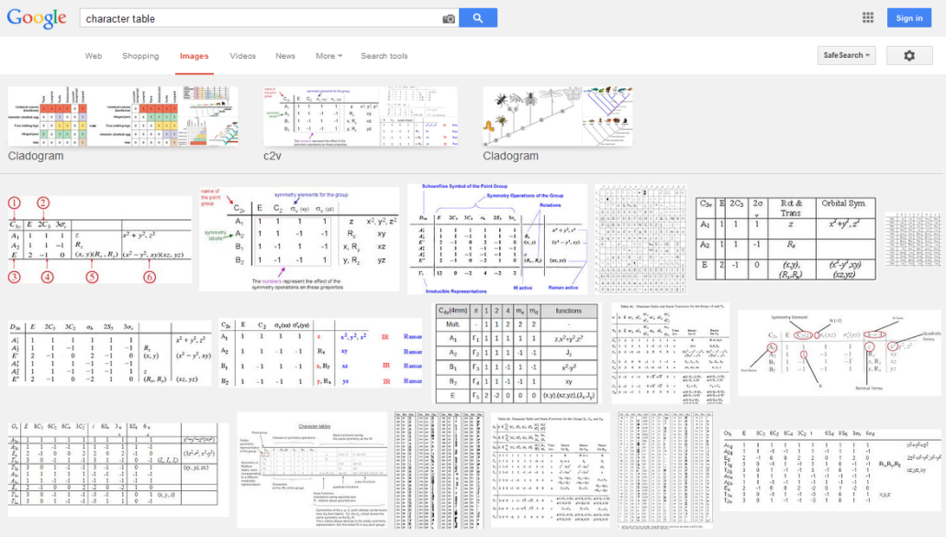
Disclaimer
When am I going to use this?
Maybe never… at least not directly
deriving character tables
predicting/interpreting IR
orbital diagrams
solving structures from IR
Inorg. Chem. text book
Google
DFT calculations
XRD and NMR
But…
Used in crystallography
Tuning ligands
Foundational to our current working knowledge
Build your conceptual framework
If you teach!
Also
Group theory is amazing!

Slide 19
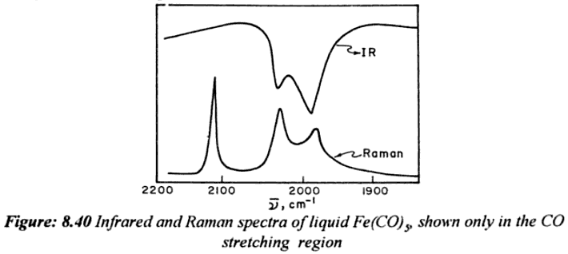
Symmetry in Chemistry
Given the following Raman and IR spectra of Fe(CO)₅ and your character tables, is the molecule square pyramidal or trigonal bipyramidal?
or
Symmetry of Spectroscopy of Molecules by K. Veera Reddy

Slide 20
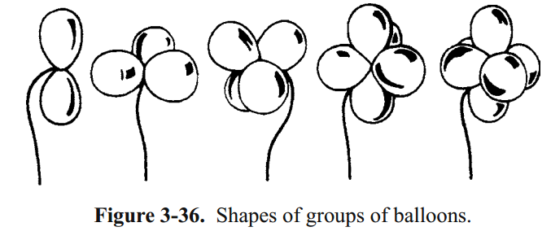

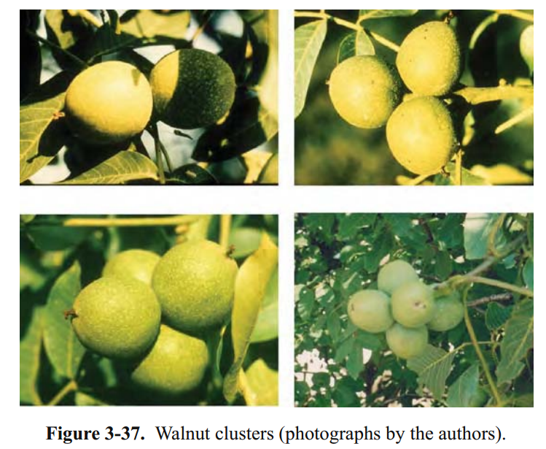
Symmetry in Chemistry
balloon animals + 200 year old math = structure of Fe(CO)₅
or
Group theory is amazing!

Slide 21
Syllabus
Office Hours:
1:00-2:00 MWF

Slide 22
Syllabus

Slide 23

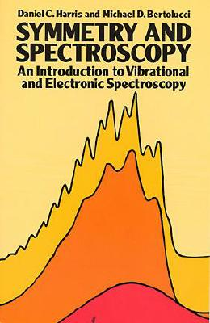

Optional Texts

Slide 24

Infinite Text

Slide 25
Syllabus

Slide 26
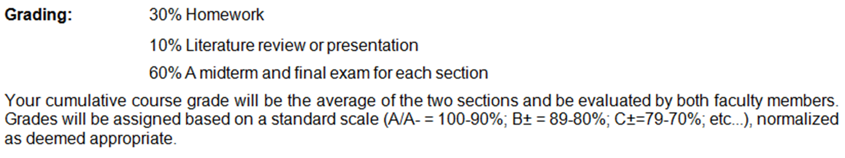
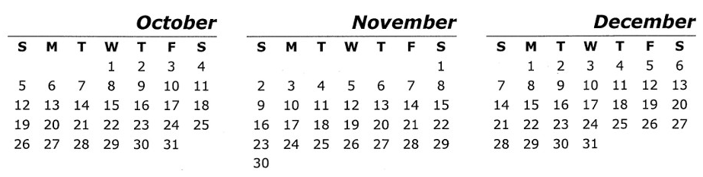
Syllabus
(3 x Assignments)
(5 min presentation)
(2 x Tests)
Test 1
Test 2
Homework 1
Homework 2
Assigned
Assigned
Homework 3 Due
Due
Topic for 5 min presentation Due
Due
5 min presentation Due

Slide 27
Syllabus
Due December 1st
Homework 3
Edit Wikipedia with something(s) relating to group theory
Send me a “before and after” of your edits
Presentation
Make a 5 minute GeoSet video relating to group theory
Send me a link to your video

Slide 28
Why the weird homework?
Generation of new shared content!
Not “wasted” labor.
General Chemistry:
Low end estimate:
~3,000 4-year colleges in the US¹
100 students/semester
15 weeks/semester
2 semesters/year
3 hrs of class + 3 hrs of outside work
repeat for 50 years
2.7 x 10⁹ hours
6.75 x 10⁷ work weeks (40 hours)
308,219 years
3916 lifetimes (avg = 78.7 years)²
U.S. Department of Education, National Center for Education Statistics. (2013)
Organization for Economic Cooperation and Development (OECD)

Slide 29
Why the weird homework?
Generation of new shared content!
Not “wasted” labor.
General Chemistry:
Manhattan Project:
2.7 x 10⁹ hours
6.75 x 10⁷ work weeks (40 hours)
308219 years
3916 lifetimes (avg = 78.7 years)²
~125,000 people
60 hours/week for 4 years
= 1.56 x 10⁹ hours
2260 lifetimes (avg = 78.7 years)²
Do homework AND contribute content to the online community!

Slide 30
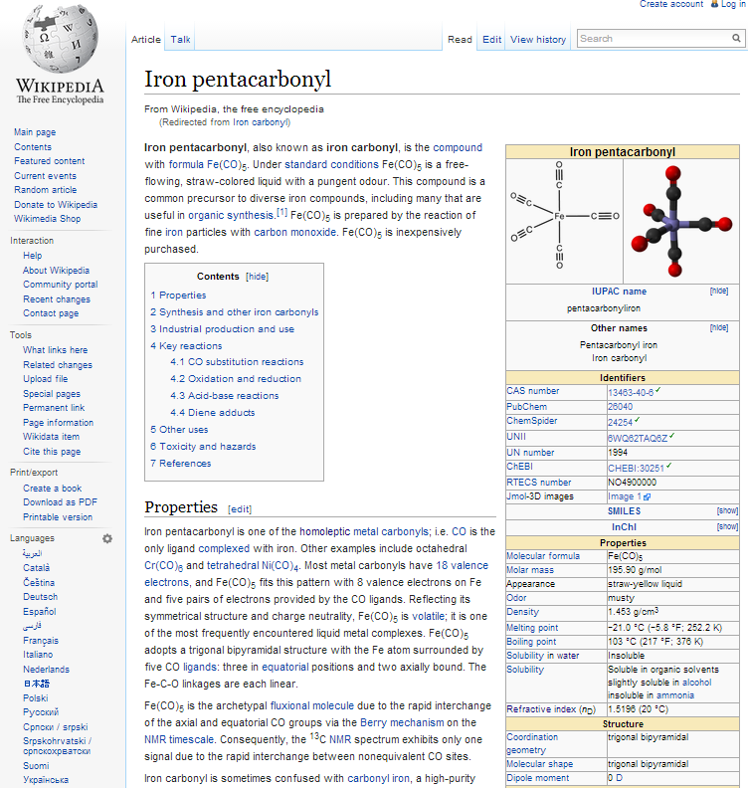
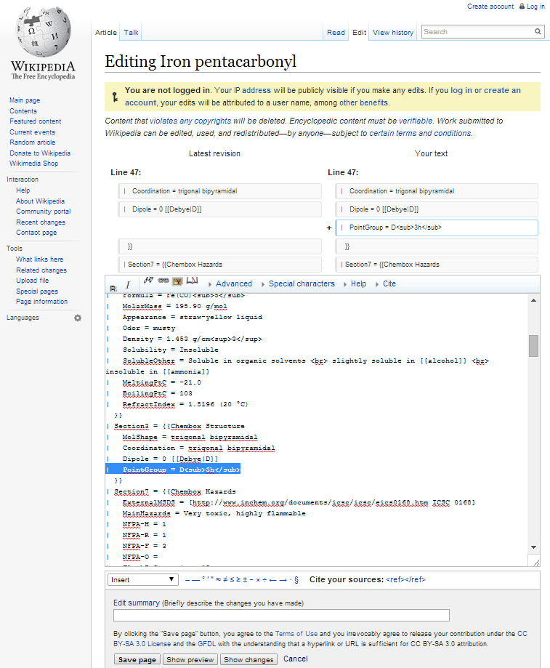
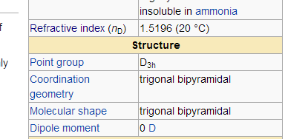
Homework 3: Edit Wikipedia

Slide 31
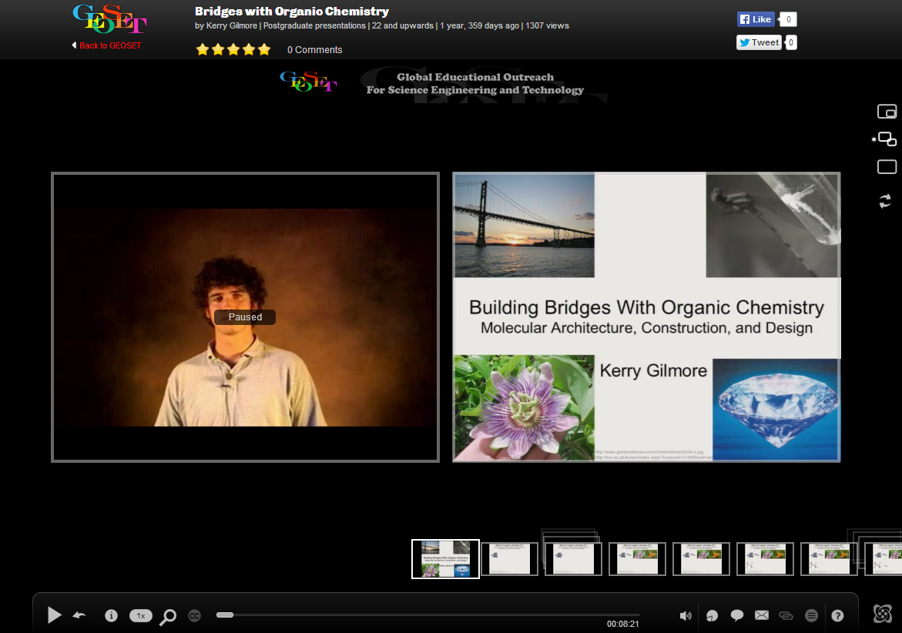
Presentation GeoSet Video
http://mediasite.oddl.fsu.edu/Mediasite/Play/93aa9659299a495c8d9ed939cc25911f1d

Slide 32
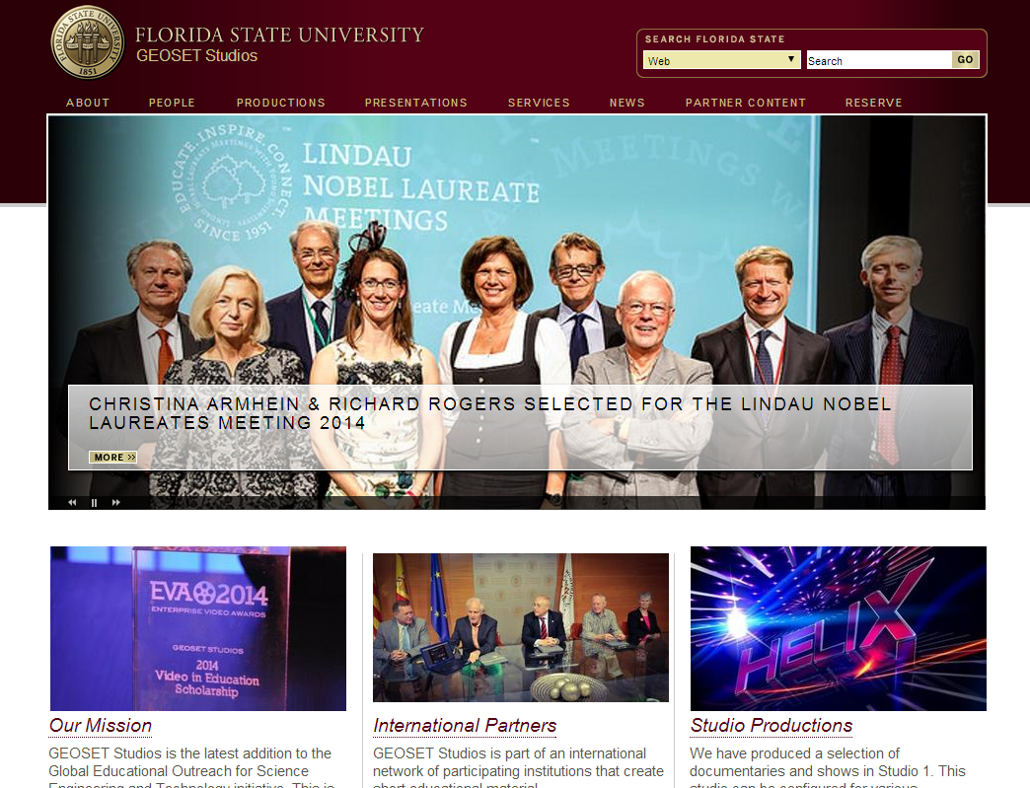
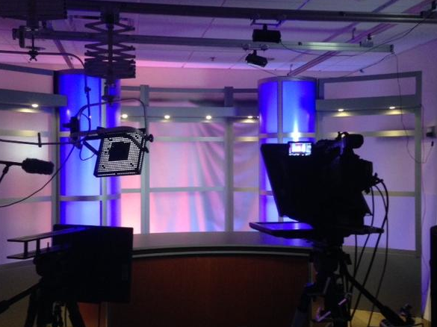
GeoSet Video
http://www.geoset.fsu.edu/
Dirac Library RM 207B

Slide 33
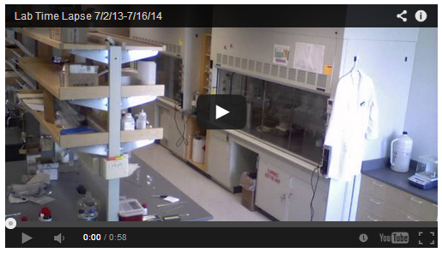

Beware of the Internet
Original Content = Feedback
A Year in the Life of a New Research Lab…in Less than One Minute
Cunningham’s Law- The best way to get the right answer on the Internet is not to ask a question, it's to post the wrong answer.
“People online generally don’t want to be helpful, but they do want to be the smartest person in the ‘room.’” -shammalamala

Slide 34
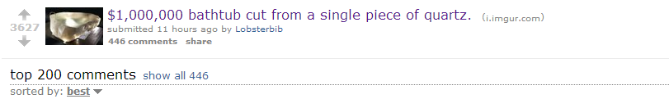
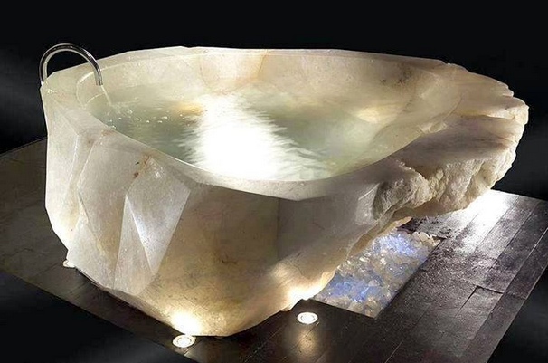
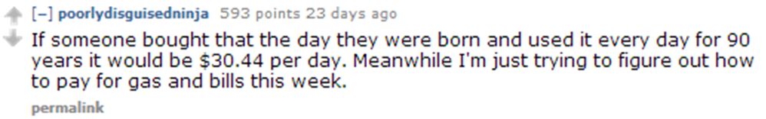
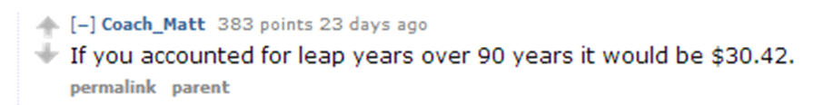


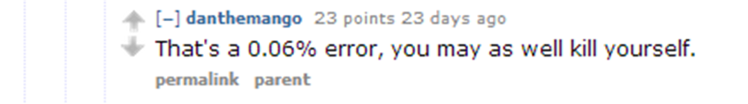
Beware of the Internet
Develop a thick skin!
It will help you deal with reviews, rejections, qual exam questions, group meetings, etc.

Slide 35
Syllabus
(3 x Assignments)
(5 min presentation)
(2 x Tests)
Test 1
Test 2
Homework 1
Homework 2
Assigned
Assigned
Homework 3 Due
Due
Topic for 5 min presentation Due
Due
5 min presentation Due

Slide 36
Why the Camera?
1) Generating new content.
2) Cottrell Scholars Collaborative New Faculty Workshop Evaluation Study
Professor Marilyne Stains
University of Nebraska-Lincoln
-Evaluation of the impact of science education research on instructional practices in higher education
Anyone in witness protection?

Slide 38
How do I teach?
Student Reviews (What should be improved?)
I think the class is great this way but it could be a little bit longer.
Give homework feedback sooner.
Could use more homework/quizzes.
Give more in class questions.
He talks too fast. Need some pause in class.
I’m still wondering what is in the right corner of the room. Just a weird spot to look at while talking to the class.
This Class
PowerPoint slides
Continue with lots of imagery
Give homework feedback sooner
More in class questions
Slow Down
2 min break every 10 minutes
Not stare at the corner?

Slide 39
Course Outline
Intro to Symmetry Elements and Operations
Point Groups Types/Assignments
Dipole Moments and Chirality
Rules that Govern Symmetry
Character Tables
Using Character Tables
Orbital Diagrams
Electronic Spectroscopy
Vibrational Spectroscopy
-Infrared
-Raman
Crystallography (maybe)

